Slide 1
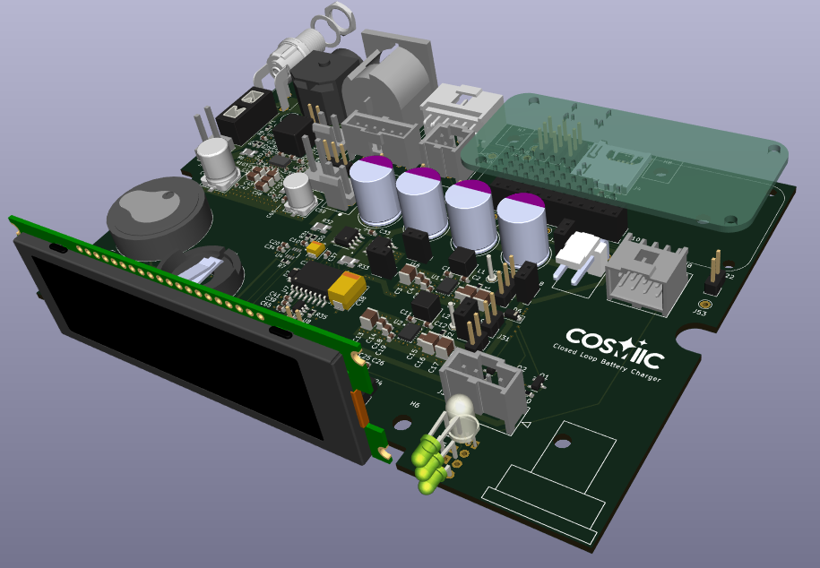
WING - Wearable Interoperable Neuroprosthesis Gear
Closed Loop Battery Charger
Design Review
2024-Mar-04

Slide 2
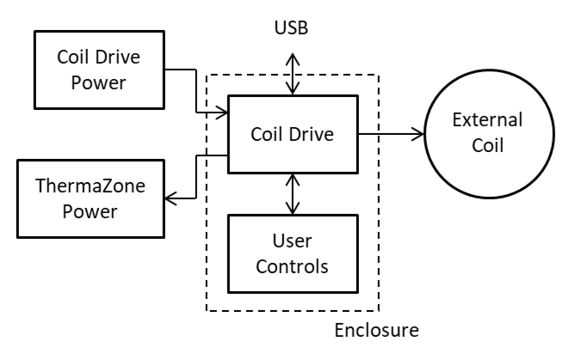
Closed Loop Battery Charger Coil Drive System
The CLBC system is a small enclosure that contains the coil drive circuitry and provides various user inputs and outputs. It is powered by a desktop AC adapter, which can also provide power to the ThermaZone coil cooling device.

Slide 3
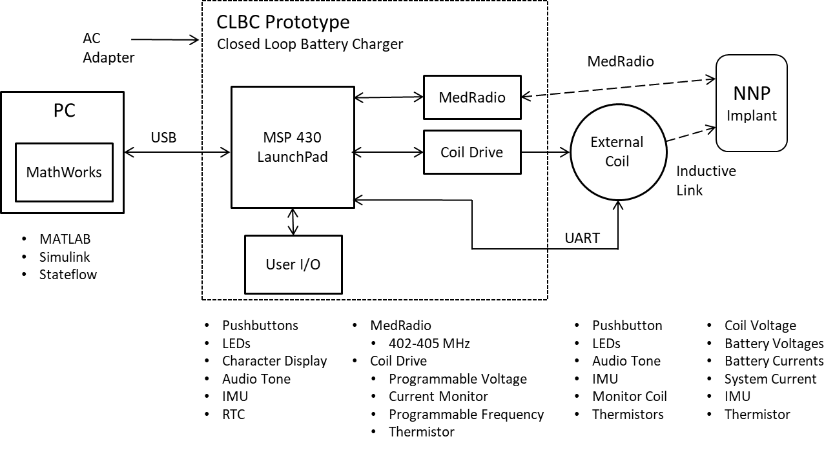
Closed Loop Battery Charger - Prototype System

Slide 4
Closed Loop Battery Charger System - Rev A
Leverage the Wireless Link
Wired and Wireless I/O
User Interface
Pushbuttons
LEDs
Audio
API
Add:
Coil Drive
Programmable Voltage
Programmable Frequency
Power Monitor
4x20 Character Display
Real Time Clock
uSD Memory Card
Enclosure Temperature
Cooler Power Output

Slide 5
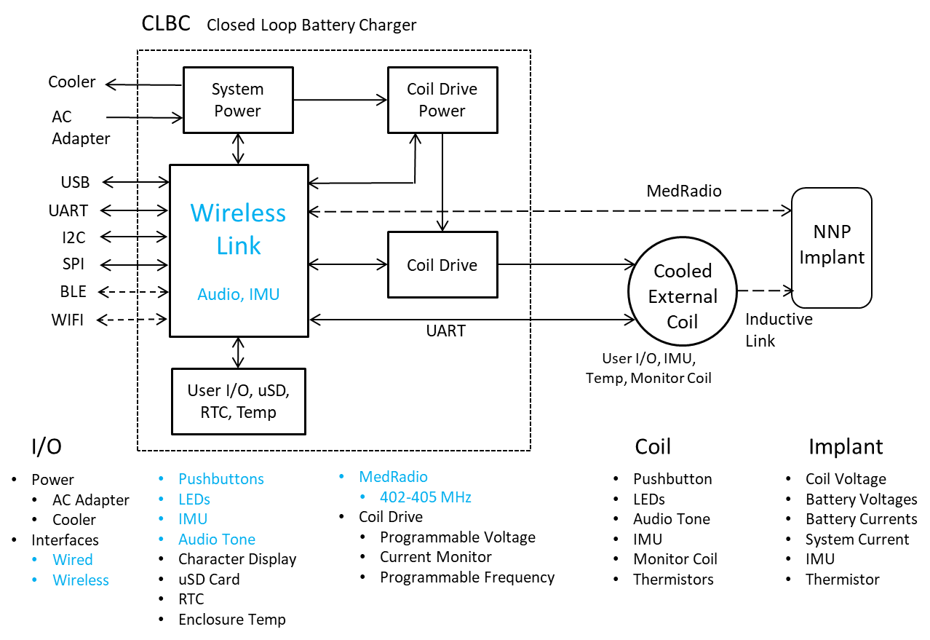
Closed Loop Battery Charger System - Rev A

Slide 6
CLBC System Rev A - Design Approach
Leverage the Wireless Link
nRF5340
Open Source Development Environment – Zephyr RTOS
CLBC is a Superset
Leverage the CLBC Prototype
Coil Drive
Coil Drive Power
Display
Open Source Focus
KiCad EDA
Schematic Capture
PCB Layout
Bill of Materials
Economical Fabrication
Enhanced Development Tool
Clinical
System Developers

Slide 7
CLBC System Rev A - Mechanicals
Use LAB2 Enclosure
Pactec LH64-130
6.08 x 4.26 x 1.50 inches
Binder Coil Connector
Add
4 x 20 Character Display
LED(s)
Pushbuttons
Various Power Connectors
Removable Access Panel
Developer I/O Connector
Wireless Link USB Connector
uSD Memory Card

Slide 8
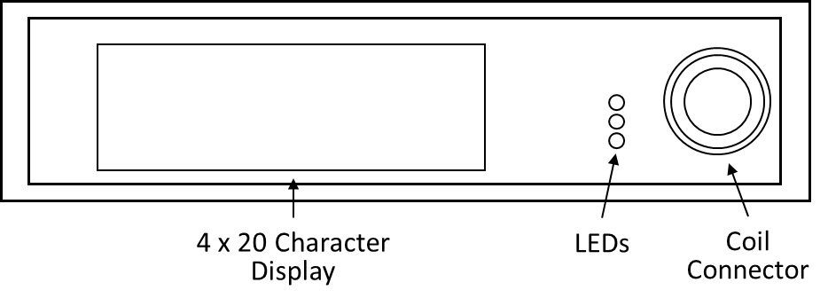
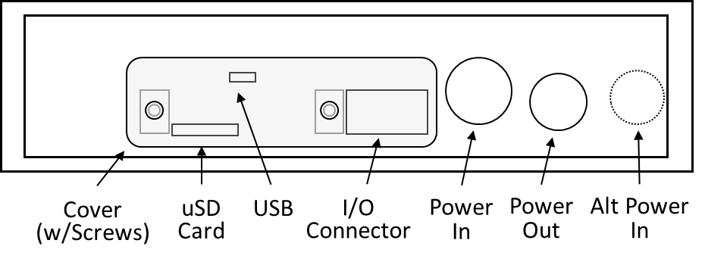
CLBC System Rev A - Mechanicals

Slide 9
Closed Loop Battery Charger System - Rev A

Slide 10
CLBC System Rev A - Circuit Design
Focus on Both End Users and System Developers
Minimal End User Accessibility
Closed System Development Accessibility
USB Connector
I/O Connector
Opened System Development Accessibility
Jumpers
Monitor Points
Leverage Reuse
Existing Proven Design
Evaluation Modules

Slide 11
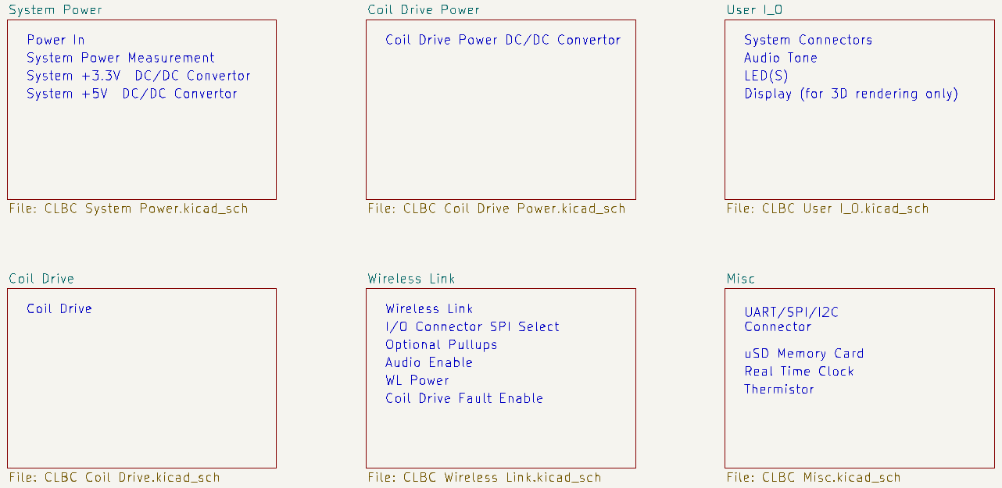
CLBC System Rev A - Circuit Design

Slide 12
CLBC Rev A Circuit Design - System Power
Power In
Existing Control Tower AC Power Adapter
ThermaZone Cooler Power Output for a System Requiring a Single AC Power Adapter
Optional Alternative Barrel Power Connector
Battery Connector
System Power Measurement (INA236 w/I2C Interface)
Input Voltage
Input Current
Calculates Input Power
System +3.3V
Buck/Boost DC/DC Convertor (LTC3130-1)
Wireless Link
Jumper Selectable
System +5V
Buck/Boost DC/DC Convertor (LTC3130-1)
Coil Drive
Jumper Selectable Power to WL
Multiple Voltage and Current Measurement Points
Convenient Ground Connectors

Slide 13
CLBC Rev A Circuit Design - Coil Drive Power
Buck/Boost DC/DC Convertor (TPS55289)
Programmable Output Voltage
I2C Interface
Same as CLBC Prototype

Slide 14
CLBC Rev A Circuit Design - Coil Drive
Same Proven Circuit used in the Control Tower, LAB2, and CLBC Prototype
Based on LT1158 - Half Bridge MOSFET Driver
System Power Measurement (INA236 w/I2C Interface)
Coil Drive Voltage
Coil Drive Current
Calculates Coil Drive Power
Multiple Voltage and Current Measurement Points
Alternative Coil Drive Power Connector

Slide 15
CLBC Rev A Circuit Design - User I_O
System Connectors
Pushbuttons
Display
Recharge Coil
Extra Pad Connected Pins for Each Connector (Future Expansion)
Audio Tone
Duplicate of Wireless Link
Pushbuttons - 2
Duplicate of Wireless Link
LED(s)
Tricolor Duplicate of Wireless Link
On Board
Three Discrete Colors
On Board
Connector
Display
OLED 4 x 20 Character
I2C Interface
Enhanced CLBC Prototype

Slide 16
CLBC Rev A Circuit Design - Miscellaneous
Developer I/O Connector
I2C
SPI w/CS
UART TX/RX
Power
+3.3V
+5V
VD (Power In)
GND
Not End User Accessible
uSD Memory Card
Not End User Accessible
Real Time Clock
CLBC Prototype
I2C Interface
Thermistor
CLBC Prototype, LAB2, CT
I2C Interface

Slide 17
CLBC Rev A Circuit Design - Wireless Link
Wireless Link Module Footprint
2x8 and 2x12 Expansion Connectors
Wireless Link USB Connector
Not End User Accessible
Wireless Link Power Jumper
I/O Connector SPI Select
Optional Additional Pullups
SPI
Pushbuttons
Audio Enable on Motherboard
Coil Drive Fault Jumper

Slide 18
CLBC Rev A Circuit Design - Wireless Link
GPI/O Mapping
40 Wireless Link Connections
11 WL Specific Peripherals / Other Functions Connected to Pads and/or Jumpers
16 CLBC Specific Functions
6 Duplicated Functions
LED(s)
Pushbuttons - 2
Audio Tone
7 Power
“CLBC GPIO Map 240206.xlsx”
Wireless Link Use
“Production” Boards
Add 2 Connectors
2 x 8
2 x 12
Operate at 3.3V

Slide 19
CLBC Rev A Circuit Design - Schematic / PCB
KiCad EDA 7.0.8
Schematic Capture
PCB Layout
5.6 x 4.0 Inch
SMT / Through Hole
4 Layers
3D Rendering
Bill of Materials
Ported to Excel
Manufacturer Part Numbers
Vendor Part Numbers / Links

Slide 20
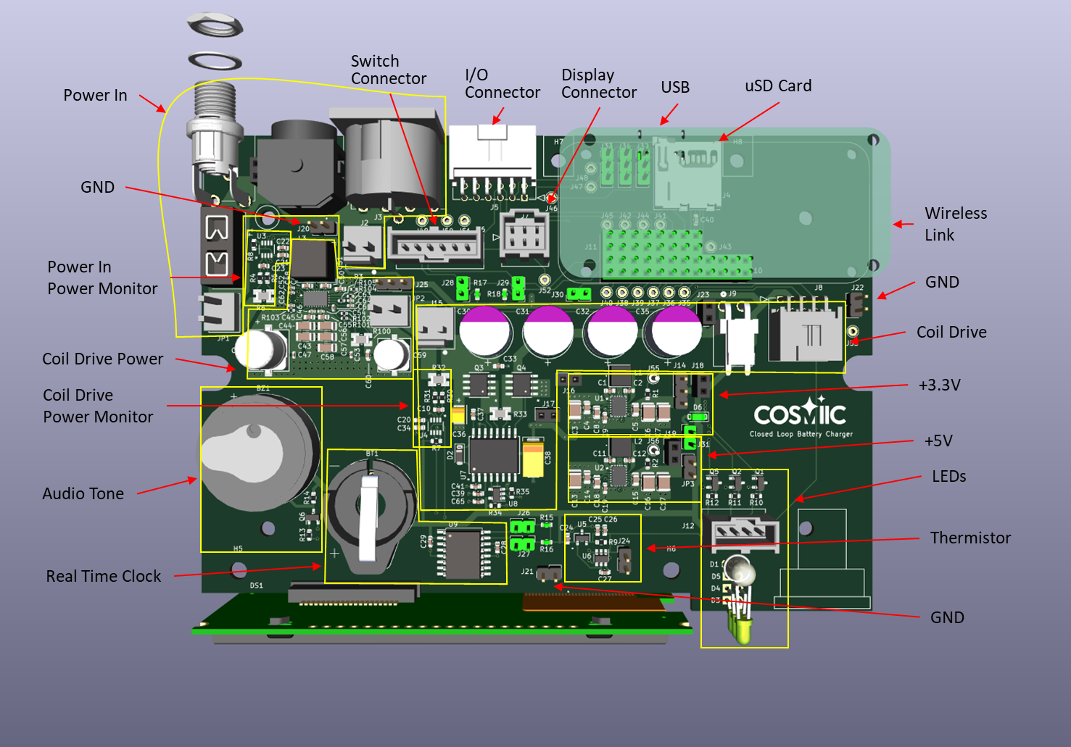
CLBC Rev A Circuit Design – PCB Real Estate

Slide 21
CLBC Rev A Design - Status
Schematic 97% Complete
PCB Layout 97% Complete
PCB Left to Do
Ground Plane on Back Layer
Geographical Reannotation
Additional Jumpers / Pads
+5V PGOOD
Coil Drive Fault
Polarity Markings on Monitor Connectors
BOM 97% Complete
BOM Left to Do
Verify a Couple of Capacitors
Resistors
Off Board Parts
Fabrication
Bare PCBs
Populate PCBs
Mechanicals

Slide 22
CLBC Rev A Design - Links
COSMIIC Confluence Pages
https://cosmiic.atlassian.net/wiki/spaces/COSMIIC/pages/edit-v2/246251532
Evaluation Boards / Key Data Sheets
TPS55289 Coil Drive Power DC/DC Convertor EVM
INA236 Power Monitor EVM
LTC3130-1 +3.3V/5V DC/DC Convertor EVM
LT1158 Half Bridge Drive
DS3231 RTC
ADS1110 ADC
NHD-0420CW-AB3 Display

